Slide 1
Computer Vision

Slide 2

How much information can your brain process?

Slide 3
Computer vision: Can we teach computers/machines to do the same?

Slide 4
Representation learning: why, what and how of CNNs
MLP for image processing and classification → Good enough?
Mnist: 28P x 28P = 784P. Iphone 11 pic resolution: Mega-Ps. How big must our neural network be?
Do neighboring pixels have correlations with one another?
Can we represent images better???
YES! CNNs!

Slide 5
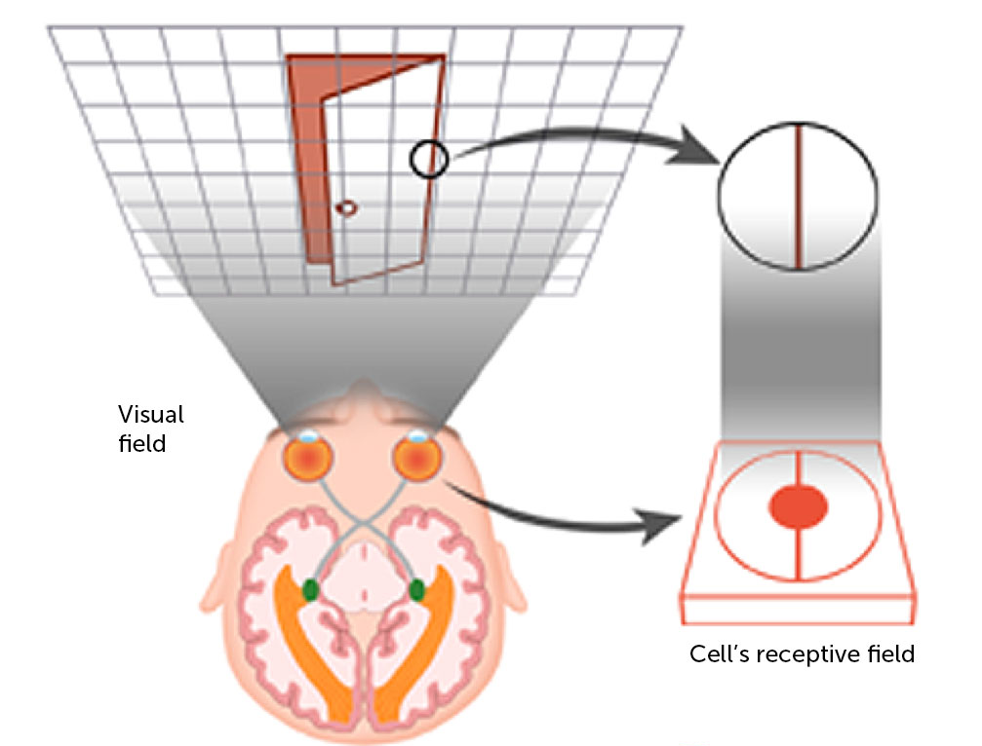
Representation learning: why, what and how of CNNs

Slide 6
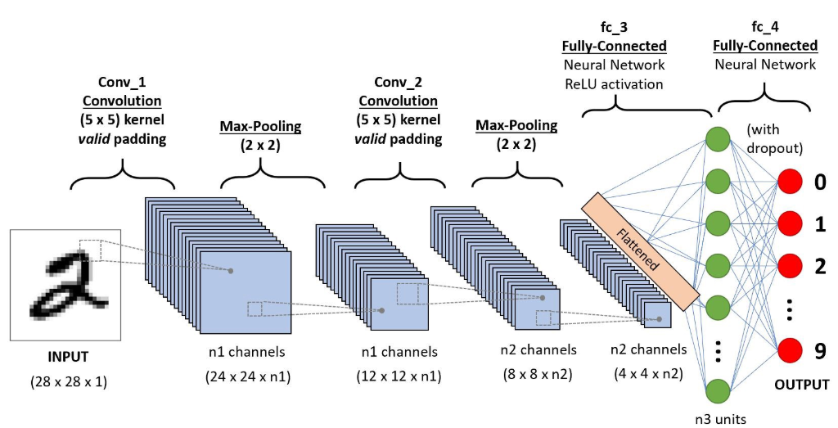
Representation learning: why, what and how of CNNs
2 operations to each convolutional layer: a convolution and a pooling operation

Slide 7
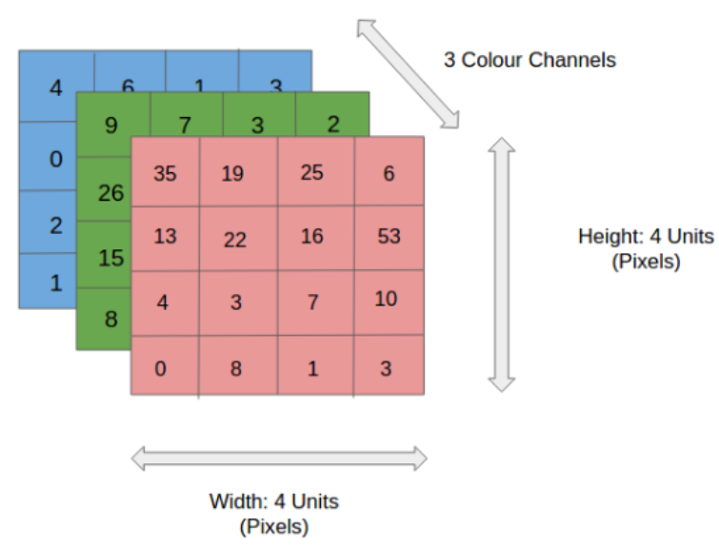
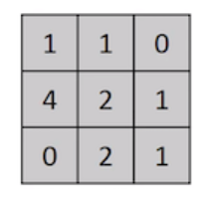
Representation learning: why, what and how of CNNs
Notes:
https://towardsdatascience.com/a-comprehensive-guide-to-convolutional-neural-networks-the-eli5-way-3bd2b1164a53

Slide 8

Representation learning: why, what and how of CNNs
Part 1: The kernel
Feature map

Slide 9

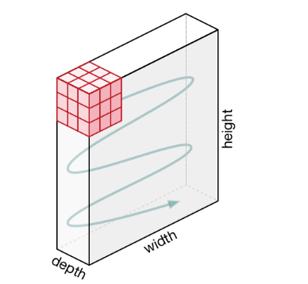
Representation learning: why, what and how of CNNs
Part 1: The kernel
N.B. Zero padding is used here

Slide 10
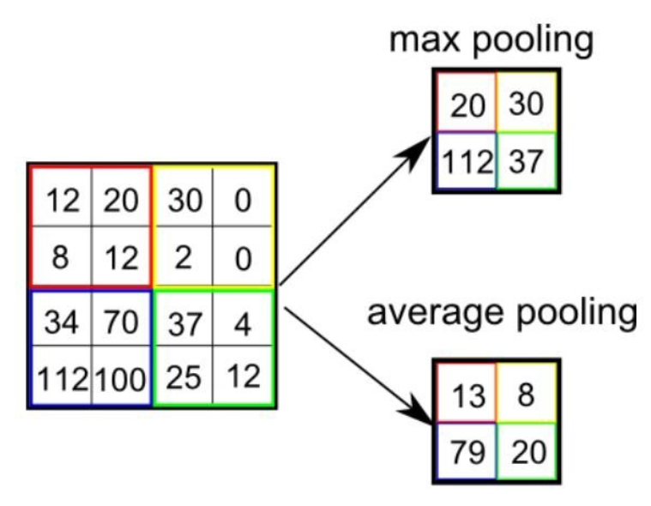

Representation learning: why, what and how of CNNs
Part 2: The pooling layer
N.B. Max pooling is generally better

Slide 11
Representation learning: why, what and how of CNNs
Hyperparameters:
Padding: Same or Valid
Stride length
Kernel_size
Number of filters
Pooling: Max or Average

Slide 12
32 x 32 x 3
Kernel convolution with 12 filters, same padding, stride 1
Putting it together into ONE convolutional layer...
32 x 32 x 12
Activation function (e.g.Relu)
32 x 32 x 12
Pooling layer
16 x 16 x 12

Slide 14
Practice!

Slide 15
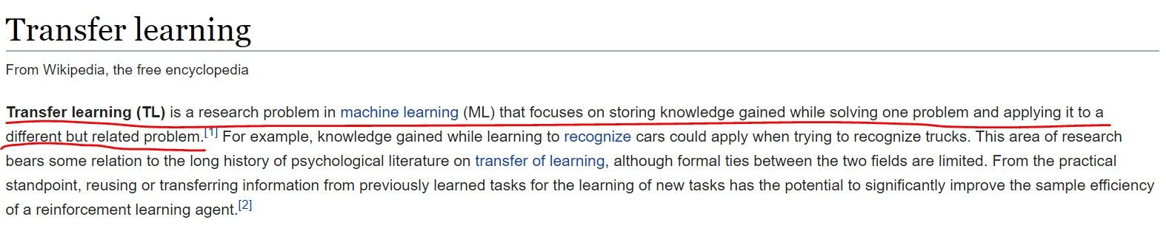
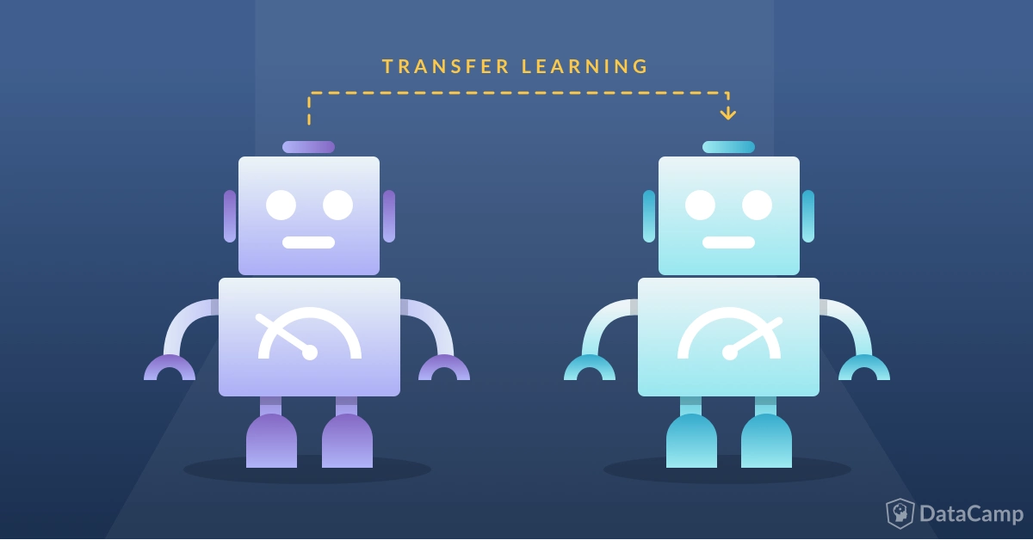
Transfer learning
???
Know how to ride a motorbike ⮫ Learn how to ride a car
Know how to play classic piano ⮫ Learn how to play jazz piano
Know math and statistics ⮫ Learn machine learning
Notes:
https://towardsdatascience.com/a-comprehensive-hands-on-guide-to-transfer-learning-with-real-world-applications-in-deep-learning-212bf3b2f27a
https://www.datacamp.com/community/tutorials/transfer-learning

Slide 16
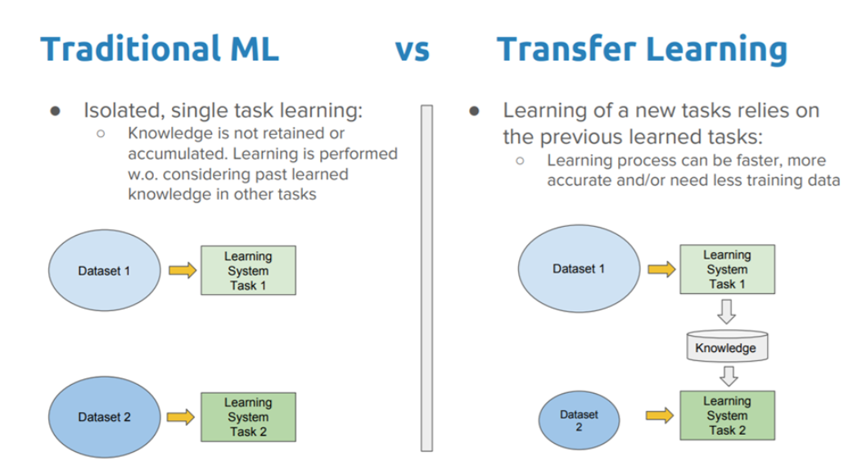
Transfer learning
The general idea of transfer learning is to use knowledge learned from tasks for which a lot of labelled data is available in settings where only little labelled data is available.
Keras provides us with pretrained models that allow for fast and efficient transfer learning!
AlexNet
MobileNet
Inception
ResNet...and many more!
Notes:
https://keras.io/applications/

Slide 17
Practice!

Slide 18
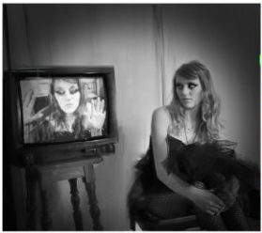
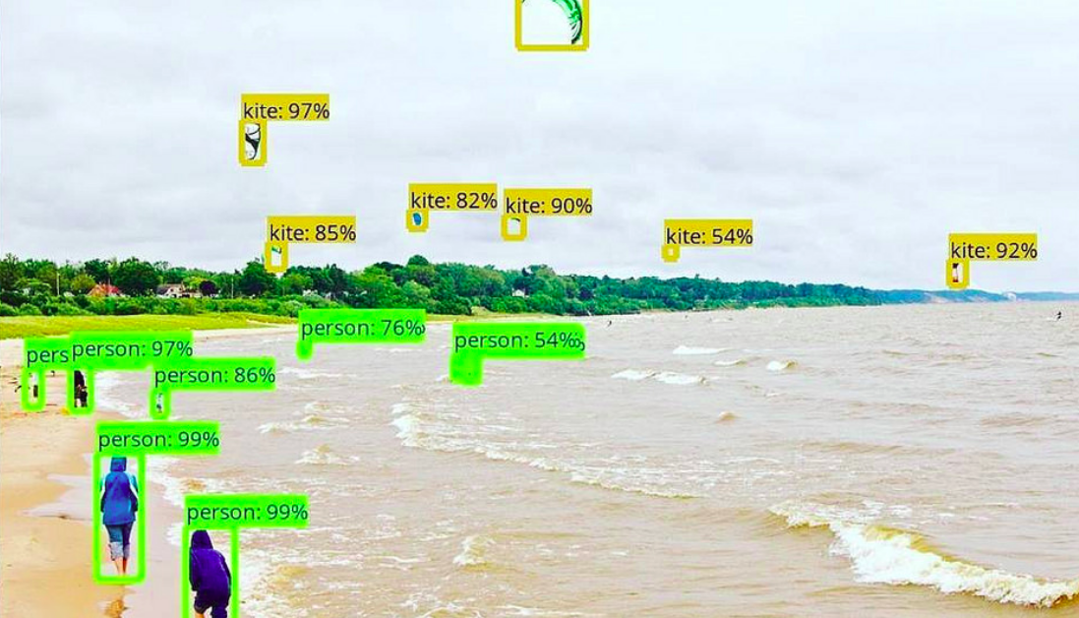
Object Detection
Image classification is good and all, but...
Notes:
https://www.analyticsvidhya.com/blog/2018/10/a-step-by-step-introduction-to-the-basic-object-detection-algorithms-part-1/

Slide 19
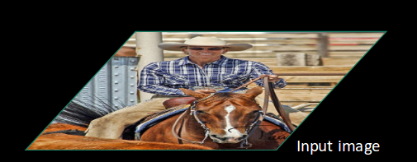
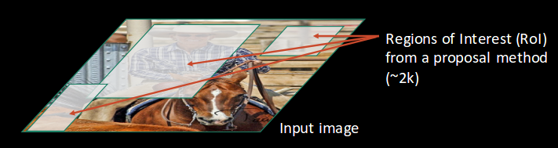
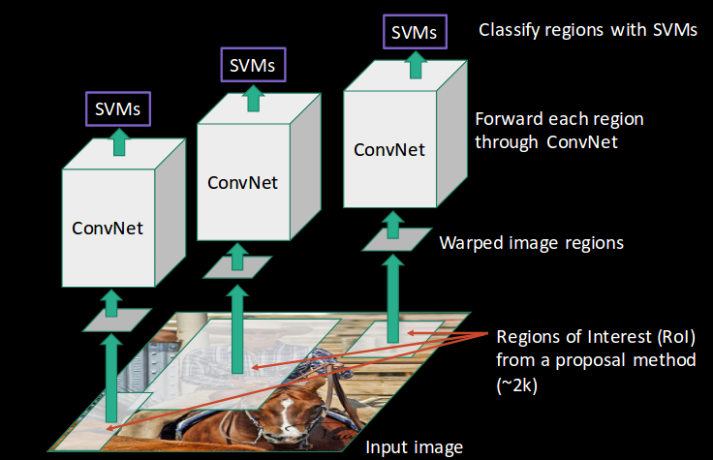
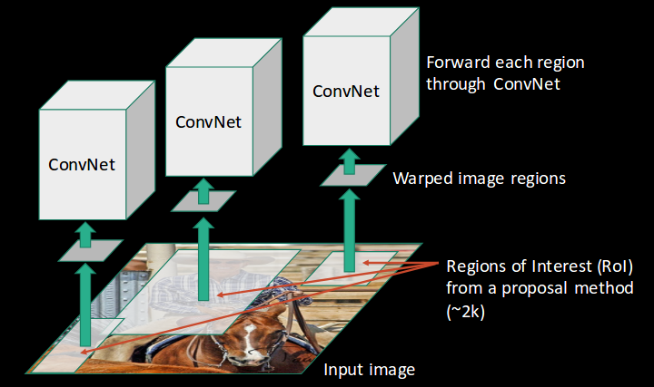

Slide 20
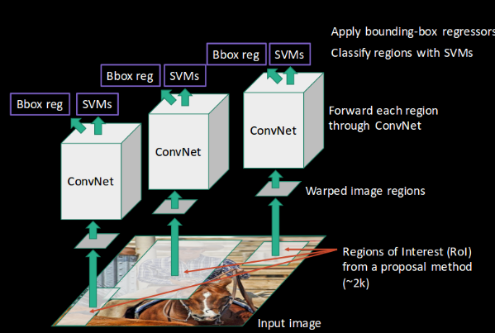
RCNN(Region-based Convolutional Neural Network):
Selective search for ROI(region of interest) proposal
CNN for feature map generation
SVM(support vector machine)/linear classifier for image classification
Linear regressor for bounding box prediction
Long processing time: takes 40-50 seconds for a prediction to be made (need to pass ~2k images through the conv net)
Computationally expensive; need to train 3 separate models.
Can we do better?

Slide 21
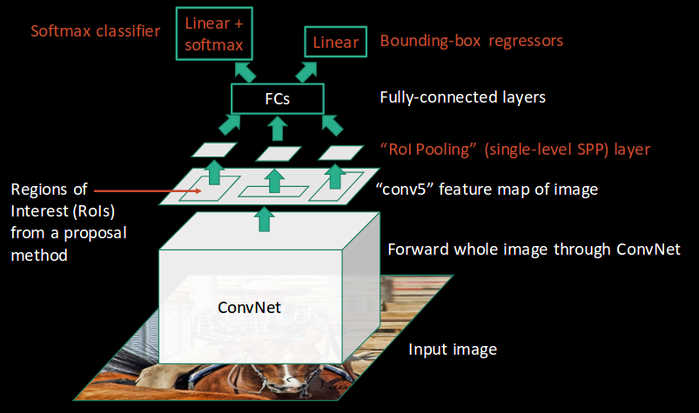
Fast RCNN:

Slide 22
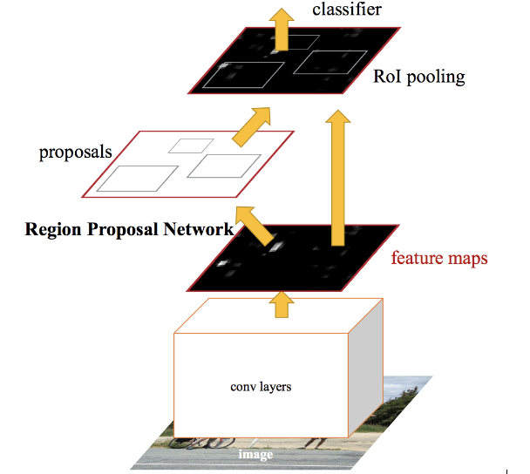
Faster RCNN:

Slide 23
YOLO and SSD

